Slide 1

Tutorial Questions （Week 15）
Juntao Zhang(张峻滔), TA
Southern University of Science and Technology
Email: 12332164@mail.sustech.edu.cn

Slide 2
Outline
Review
Tutorial Problems 8.44 8.46
Q&A

Slide 3
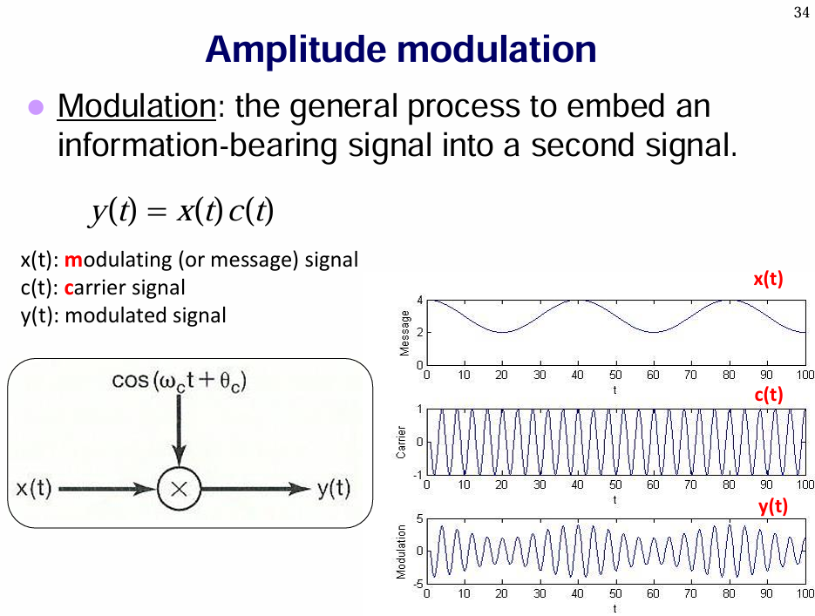

Slide 4
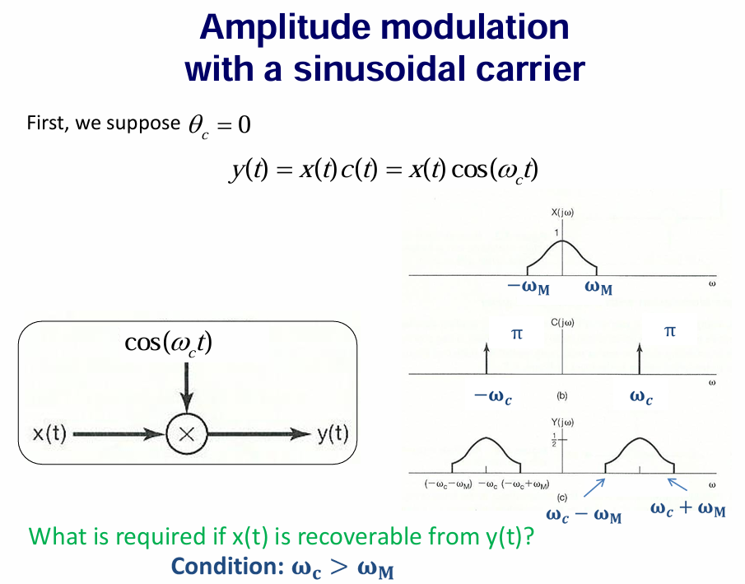

Slide 5
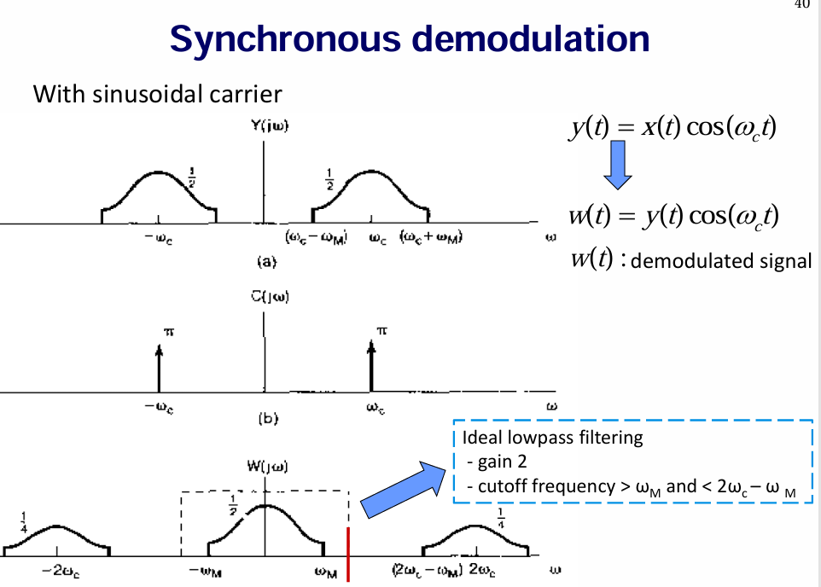

Slide 6
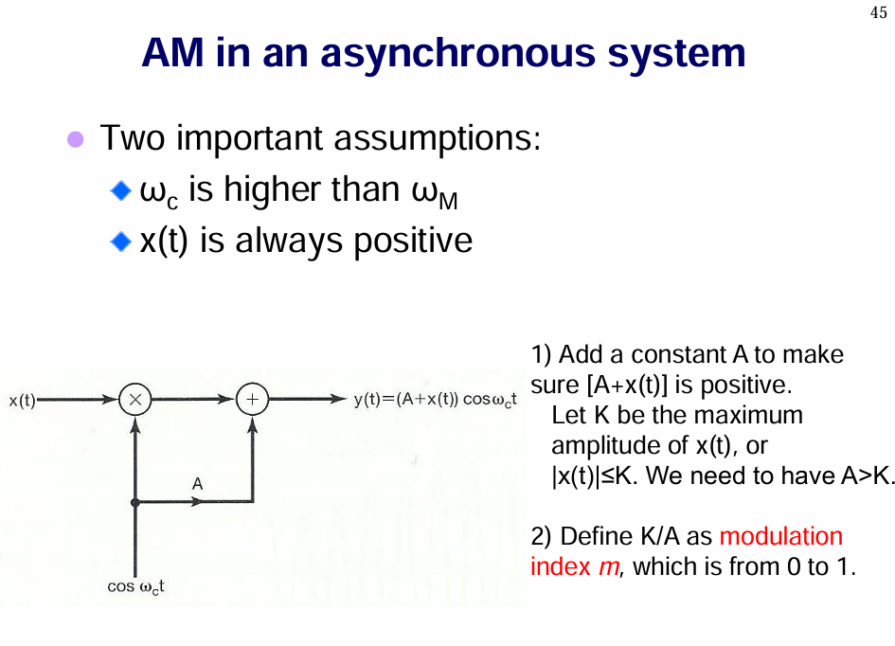
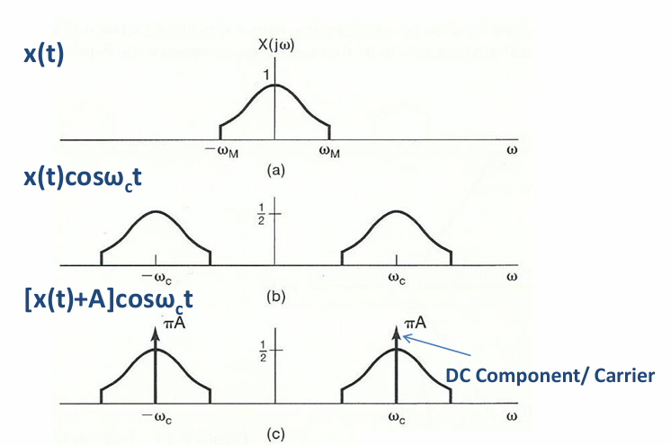
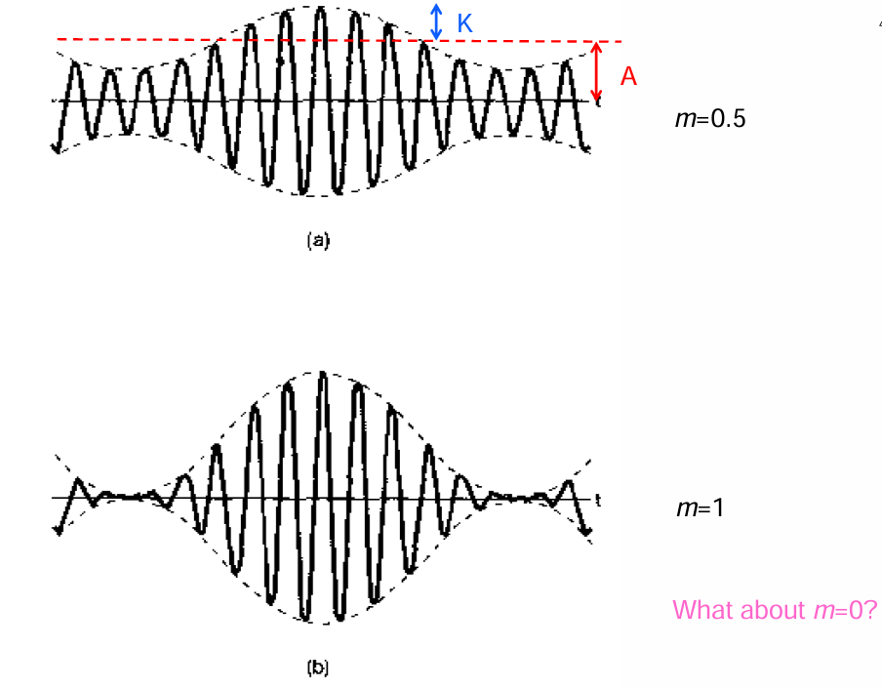

Slide 7
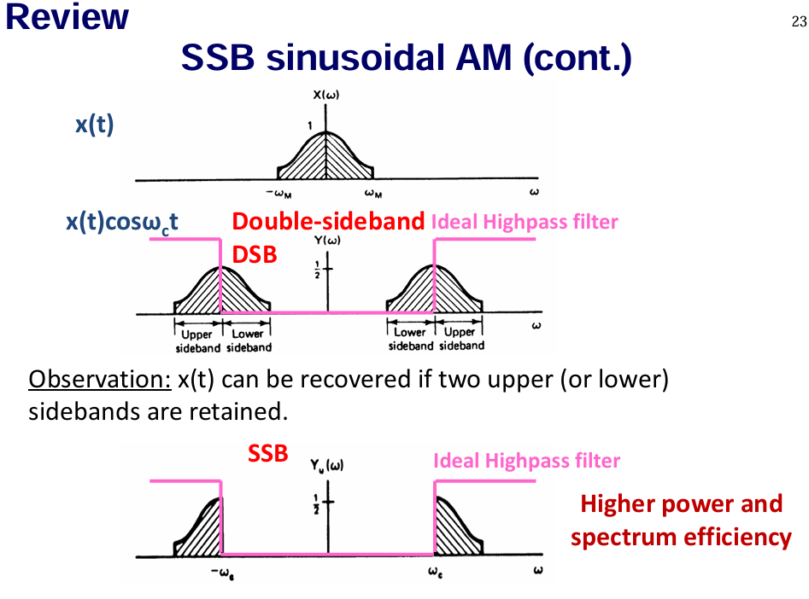
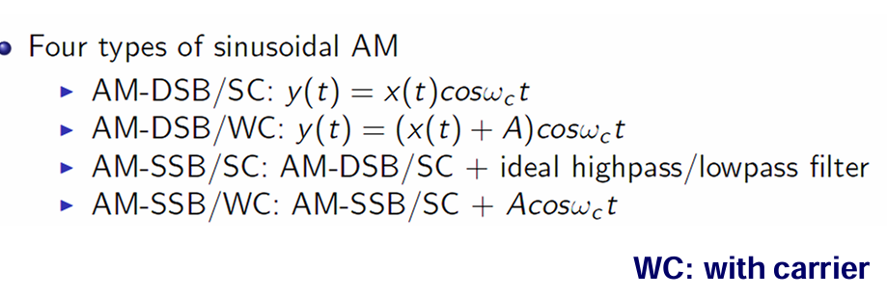

Slide 8
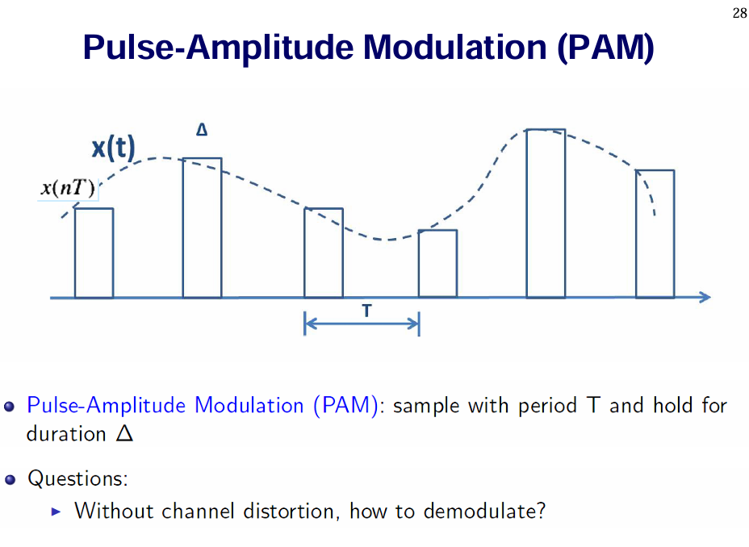

Slide 9
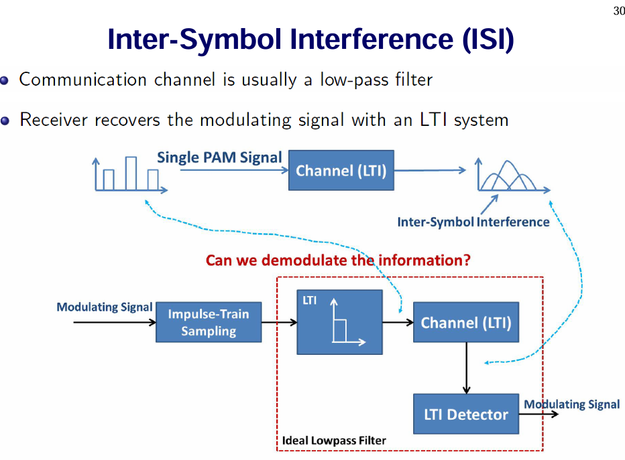
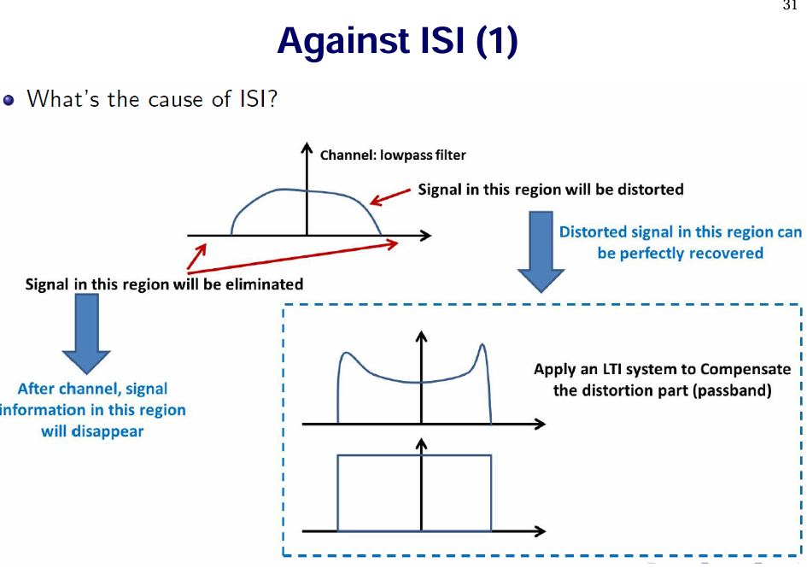

Slide 10
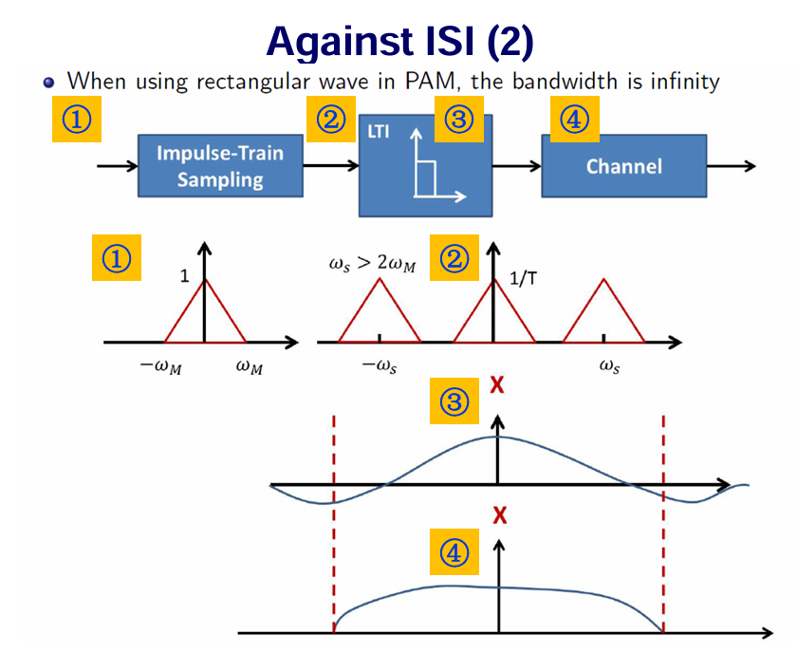
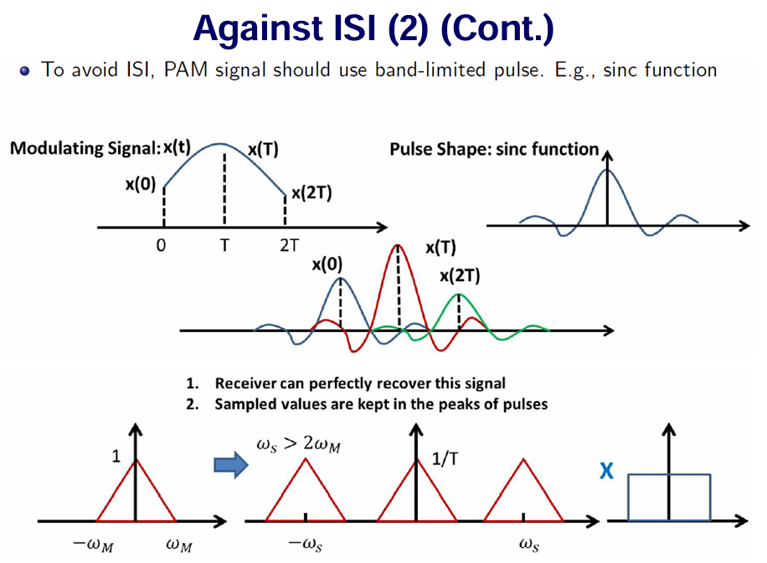

Slide 11
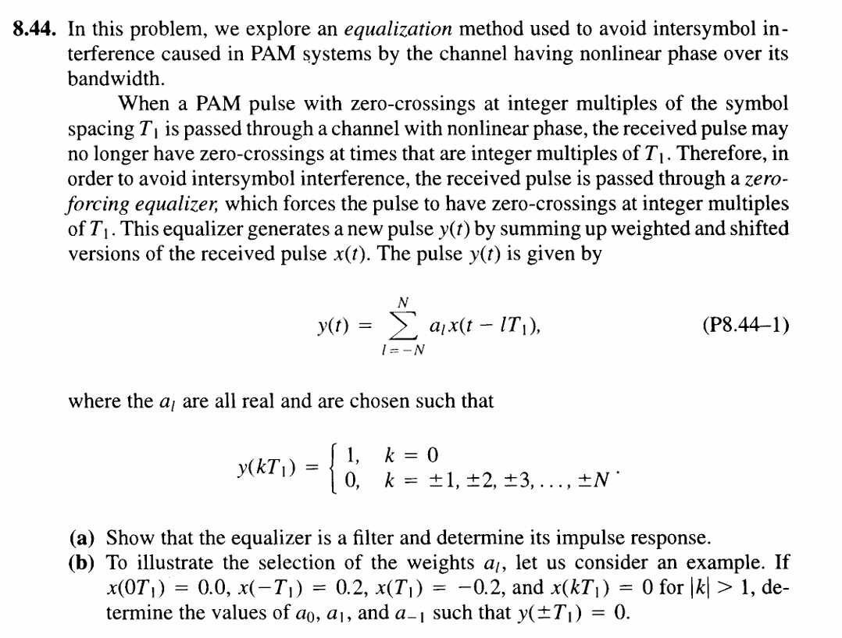

Slide 12
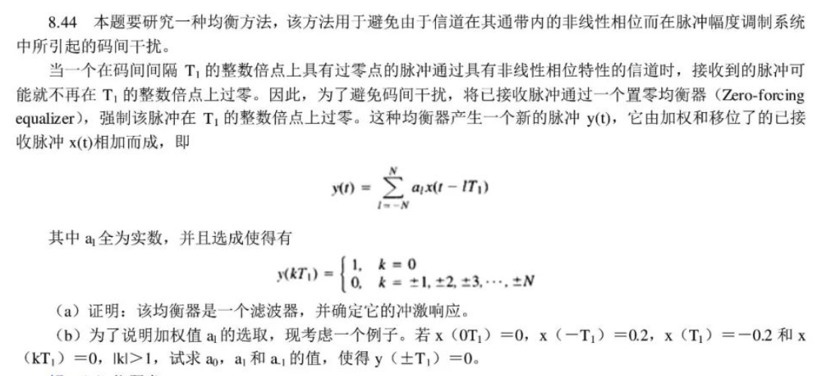
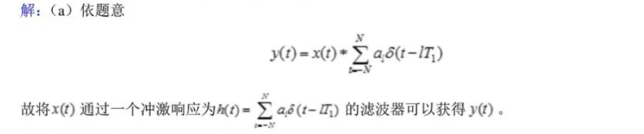
Y(0)=a₋₁x(T₁)+a₀x(0)+a₁x(-T₁)
Y(T₁)=a₋₁x(2T₁)+a₀x(T₁)+a₁x(0)+a₂x(-T₁)
Y(-T₁)=a₋₂x(T₁) a₋₁x(0)+a₀x(-T₁)+a₁x(-2T₁)
1=-0.2*a₋₁+0*a+0.2*a₁
0=0*a₋₁-0.2*a₀+0*a₁+0.2*a₂
0=-0.2*a₋₂+0*a₋₁+0.2*a₀+0*a₁
取一组值满足条件即可

Slide 13
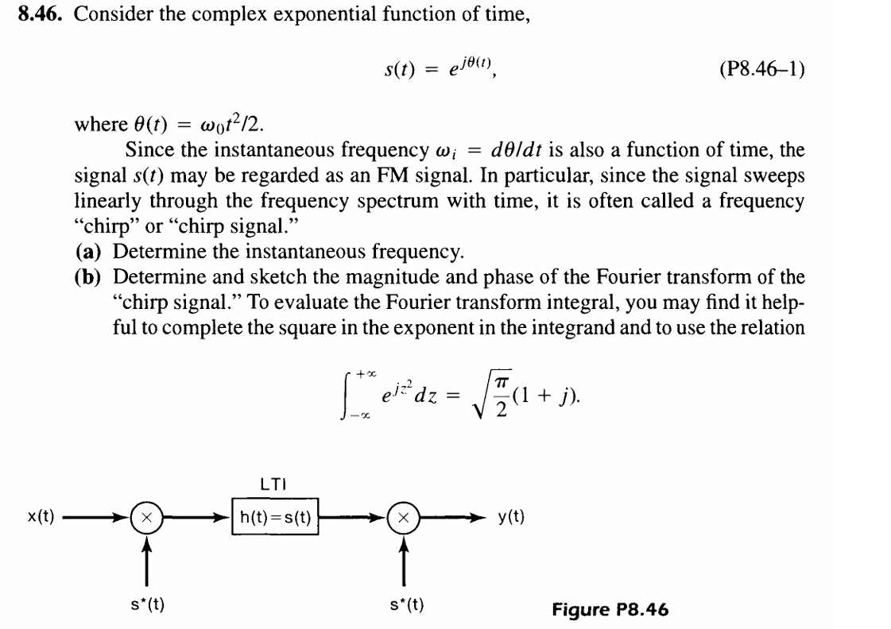
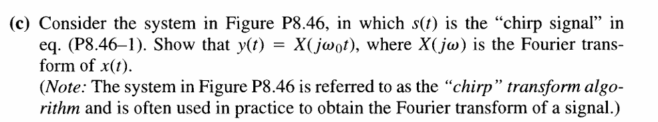

Slide 14
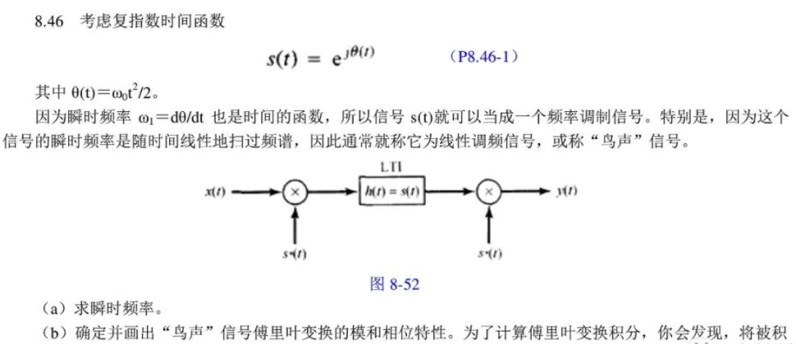
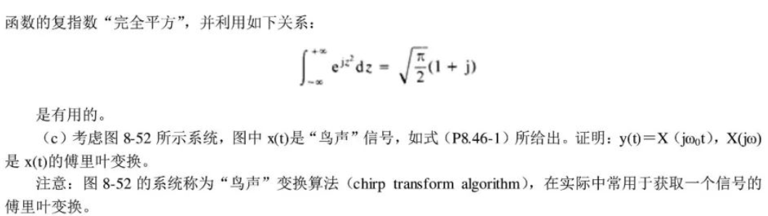

Slide 15
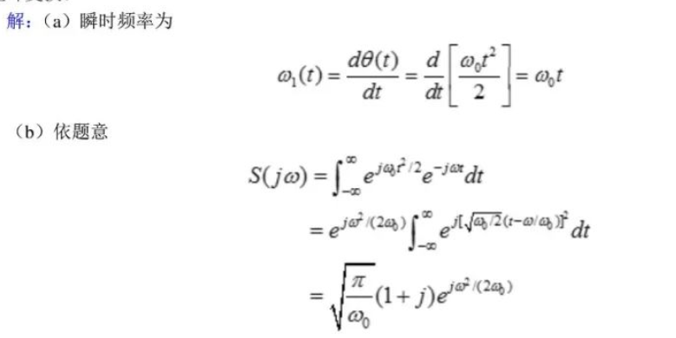
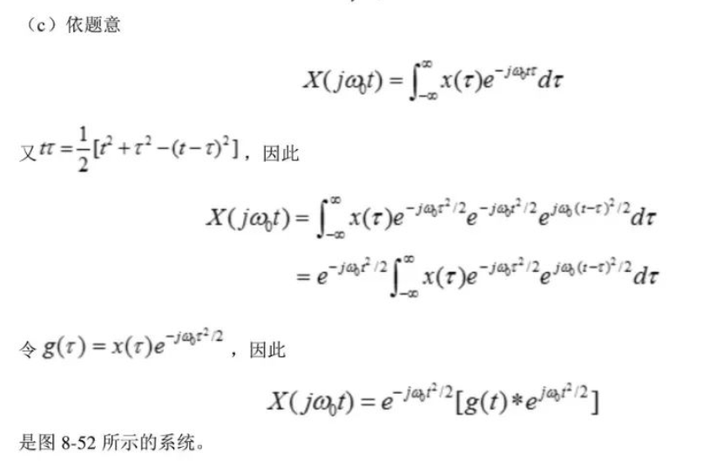

Slide 16
Thanks for Your Attendance
Q&A
Juntao Zhang(张峻滔), TA
Southern University of Science and Technology
Email: 12332164@mail.sustech.edu.cn

